Slide 1
Statefulsets, Volumes, ConfigMaps, Secrets and why should you care?
A presentation by: Giang

Slide 2
Table of contents
An example of state-less and state-ful applications
The birth of Volumes and its’ role in ”persisting” data, as managing state is hard
“Why should I bother with StatefulSets?” and other questions from a person who doesn’t know the drawbacks of Deployments “yet”
On topic of Kubernetes Volume types
A small demo

Slide 3
What does “state” means?
In order to understand a StatefulSets, we have to understand what “state” means
So in software, all software has some degree of state
In some applications it’s not obvious because the state of the application does not really impact us.
Those are usually called state-less applications
Other applications like databases, message queues, caches, have a much higher degree of state – because they rely of storage

Slide 4

Example
So let’s say we have an application this could be an ASP.NET, PHP app, NodeJS, some Apache webserver
It doesn’t really matter

Slide 5

Example
We have our customer, Andrew
Let’s say for example the server hosts our company website

Slide 6







Example
Now Andrew opens up the browser and types the address of the website in the browser
The browser will then hit the server
The server will load HTML files from disk and send it back to Andrew’s browser
So now Andrew will now reach and see our website
And Andrew is happy

Slide 7




Example
But what if that single server dies?

Slide 8



Example
That is why in web applications we normally have a second webserver
And we also have the same HTML files deployed to the second server
Then we use this thing called a Load Balancer
We could send 50% of the traffic to the one server, and the other 50% to the second one

Slide 9


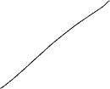

Example
That means if one of them dies our application is still available
Now the HTML files on the server has some degree of state
We can see even if the load balancer is requesting files from different servers, it doesn’t really impact our customer
Although our application here has a very low degree of state – meaning that the state doesn’t really impact Andrew
→ This here is a state-less application

Slide 10

So because our application is just serving basic HTML files there is no state that ties Andrew’s browser to our server
That means our application is state-less
Building state-less application is always encouraged because managing state is hard

Slide 11


A stateful scenario
Session
and
a cookie
{
“username”: “Andrew”,
“password”: “1$wj2ndi&*$”
}
Let’s say now Andrew has to login in our website
Andrew types in a username, and a password
Usually when a login happens on a website, we generally take the username and password
After we’ve authenticated, we create a sessionID and a cookie that we store in the browser

Slide 12
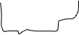

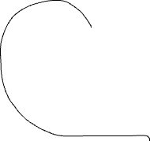

A stateful scenario
Session
and
a cookie
With HTML
files
{
“username”: “Andrew”,
“password”: “1$wj2ndi&*$”
}
When the authentication happens on a webserver
The webserver is what generates the session and stores it in memory or on disk
So now any subsequent request that comes into this webserver, the webserver can identify that this session belongs to Andrew, and can serve the HTML files to him
Session
stored
here

Slide 13





A stateful scenario
{
“username”: “Andrew”,
“password”: “1$wj2ndi&*$”
}
What happens if the server that stores the session dies? Or what happens if the traffic comes to the other server?
And there are no session of Andrew available in both cases
Well Andrew will be logged out, and Andrew will have a bad day
“Unauthorized”
Session
stored
here

Slide 14
That situation happens because the state of our application is tied to a webserver
That’s because the login information tied from the browser directly to the server – in which stores it in memory
This is not a good architectural design

Slide 15


A solution
It is always a better architectural practice to decouple the state from the webserver
In this case what we may do is deploy a data store, this could be a mem-cache, Redis, it could be a database, whatever technology you prefer to manage
Data store

Slide 16


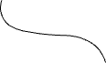
A solution
Then what we would do is we would remove the session store from the process, and we would save the session in the data store
Now the two server can come and go as they please – since we have now decoupled the state from the process
Each one of these webservers can now access the same state in the data store
Session
Data store

Slide 17


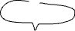


A solution
So now we’re back at the point where we have a Stateless application and this over here is called a Stateful application
Session
Data store

Slide 18
Terminologies
Stateful applications like Redis, memcaches, databases like NoSQL or SQL may use memory for fast access to data
But it usually persists the data somewhere on disk
To make things a little bit more complicated, some of these Stateful applications like databases may use its’ own replication technology to replicate data among multiple instances to achieve high availability (like MongoDB has their own ReplicaSet implementation, in which I’ll cover in the demo)

Slide 19
The birth of Volumes
Let’s take everything we know and try to imagine use deploying a SQL database onto Kubernetes cluster
You’re probably wondering why don’t we just use a Kubernetes deployment to deploy our SQL database
In this section I’ll show you the differences between Deployments and a StatefulSet
To understand this, let’s take a look into a deployment

Slide 20


The workings of a Deployment
POD-abc
In kubernetes, we have this thing called a node or a virtual machine that you want to run some workloads on
In a deployment, what we do is we normally create a pod
Now our pod as you can see has a random name and a random hash behind the pod name
Node

Slide 21


The workings of a Deployment
POD-abc
Let’s say we’re deploying a SQL database an instance, inside this pod. We’ll have a SQL container running in the pod
By default, SQL is not aware that it’s running inside of a container, basically it’s just going to write to the filesystem, just like the way any other database would
So it writes to the filesystem, because the container has a virtual filesystem attached to it
→ That means any data that’s written inside this filesystem is lost when that container dies
files
Node

Slide 22

A Volume’s role in persisting data
POD-abc
With containers, we normally solve this problem by mounting the files from the host into the container – this is called a Docker Volume
If you do `docker run –v /hostPath:/contPath` you can mount a host path into the container path
We can actually mount files from the node into the container, and this in Kubernetes is called a PersistentVolume of type hostpath
files
files
Node

Slide 23
Note:
Kubernetes has many different types of PersistentVolumes, I’m not going to cover all types of Volume in this section yet, but later it will be
It is essential to understand the basics of persisted volumes and how they play a role in stateful workloads

Slide 24
A Volume’s role in persisting data
POD-abc
In this example here, we’re using a host path to simulate a docker volume
What we’re doing is, now SQL is still accessing the files on the filesystem, but it’s actually accessing the files on the host
Because the host is being mounted into the container’s filesystem
writes
files
files
Node

Slide 25


A Volume’s role in persisting data
POD-abc
This is a way better than our previous solution because now our data is persisted on the node
Meaning if the container dies and gets recreated, the datastore persist
This is completely fine for some small businesses that have a one node Kubernetes cluster and maybe they’re running non-business critical workloads
writes
files
files
Node

Slide 26
A Volume’s role in persisting data
POD-abc
But it’s not good enough for business critical systems
If a machine get’s recreated, the data is lost
If the machine’s OS files, file disk, gets full, the OS is going to become unstable
Also if the pod gets scheduled on another node if you’re running more than one node in the cluster, then the data is not going to be on that server
→ So you’re going to have data loss again
writes
files
files
Node

Slide 27
PersistentVolumes
Now a much better improvement would be to take a look at other types of persistent volumes
As I noted before, there are multiple different types of persisted volumes, we have host paths
We also have different types of persisted volumes that we can either attach to a single node like an SSD drive or you can attach a network share like an NFS file storage
Every cloud provider also has their own set of persisted volumes like Azure has azureDisk, Amazon has awsElasticBlockStorage

Slide 28



Conclusion
POD-abc
In this example, let’s bring our own storage here like an NFS network share
What we do is we then use a different persisted volumes, rather than host path, now we can mount the files onto that share
We’ve enhanced the persisted volume by now instead of coupling ourselves to the container we’ve moved on to the host path
And instead of coupling ourselves to the node, we’ve advanced into an external type persisted volume
→ So now we no longer rely on the container or the host, we’re now in a much better place
writes
files
files
Node
PV attach/external

Slide 29
“Why should I bother with Statefulset?”
You might be wondering what is wrong is the deployment? What is wrong with using a deployment here and a multiple pods to store data?
Here’s the thing, there are still some fundamental problems with the kubernetes deployment in the solution

Slide 30
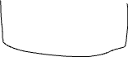
Problems
POD-abc
POD-xyz
If we take a look at this, the first problem is what if we scaled up to two pods, what if we created another pod xyz
The first thing that’s going to happen is when kubernetes scales a deployment, the pods are going to use the same persisted volume
That is because by default, pods as a part of a deployment, share the same persisted volumes across the cluster
writes
writes
files
files
Node
PV attach/external

Slide 31
Problems
POD-abc
POD-xyz
Though this is a problem for SQL, because what’s going to happen is we’re having two instances of SQL, and they’re going to write to the same storage
→ What will end up happening is pod abc will write to the same storage is pod xyz, which will result in a data corruption
writes
writes
files
files
Node
PV attach/external

Slide 32
Problems
POD-abc
POD-xyz
The second problem is that from a network point of view, pot-abc and pot-xyz don’t have a reliable way of seeing one another over the network
It’s because by default, pods in kubernetes don’t get their own dns names, and usually we use what’s called a service to expose pods to other applications in the cluster
So that means SQL in this case is going to have a difficult time trying to setup a cluster and perform replication
pod-abc and pod-xyz is not going to be able to make network calls to each other to form a master-worker replication
writes
writes
files
files
Node
PV attach/external

Slide 33

Problems
service
POD-abc
POD-xyz
The only way to get traffic between pods, is to create this thing called a service
This is okay if you have a client that wants to read the data in SQL, and because a service load balanced between pods
But it doesn’t help us if pod-abc needs to make a network call to pot-xyz
writes
writes
files
files
Node
PV attach/external

Slide 34

Problems
service
The other problem here is that we if take a look at the pod names, pods get a random hash assigned to the end of the pod name
So the pods don’t really have a network identity, they don’t have a DNS name, everytime a pod gets destroyed and recreated, it gets a new randomized name
From a data replication point of view, that is not going to be really good if you have Redis cluster, where you have a node that gets created, joins a cluster and then when it gets deleted and being recreated, it will going to have a different name
It’s going to be hard for all the different instances find each other in a cluster
POD-abc
POD-xyz
writes
writes
files
files
Node
PV attach/external

Slide 35
Problems
service
The final problem is if we scale to 4, what a deployment will do in kubernetes is it will just randomly issue 2 more pods here
Because in kubernetes, deployments just randomly scale up a number of instances and also when we scale down it will randomly terminate certain instances
This is bad for something like a Redis cluster, where you might have a very delicate need for scaling so you might want to create one pod at a time so that they can join the cluster and form a replication
POD-abc
POD-xyz
POD-jkl
POD-iop
writes
writes
writes
writes
files
files
files
files
Node
PV attach/external

Slide 36
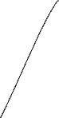
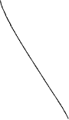

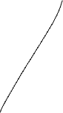


Problems
service
The same thing goes for scaling down, if we scale the solution down to one pod
What happens is kubernetes will just terminate them randomly, or severely, all at the same time
If a Redis cluster being scaled down to one at the same time, a big outage is going to be expected to happen
POD-abc
POD-xyz
POD-jkl
POD-iop
writes
writes
writes
writes
files
files
files
files
Node
PV attach/external

Slide 37
Recap
service
Pods in a deployment share the same persisted volumes
Secondly, pods have a random hash character at the end of the name → they don’t have a persisted identity
They also don’t have their own DNS so they can’t be individually addressable
Deployment scaling doesn’t really help stateful workload
POD-abc
POD-xyz
POD-jkl
POD-iop
writes
writes
writes
writes
files
files
files
files
Node
PV attach/external

Slide 38
StatefulSet in action
POD-0
Now if we change from deployment to a statefulset, let’s take a look at what improvements kubernetes have made to allow us to deploy stateful workloads
Let’s say we want kubernetes to create 3 replicas, the statefulset will not issue 3 pods at once, instead it will create our pods one by one, in a very delicate fashion
Here we will have a pod and the pod will also gets its’ own DNS name, it will start with the name of the pod, and then the number which will start at 0
files
Node

Slide 39
StatefulSet in action
POD-0
POD-1
Everytime we scale up, the number at the back will increase
Here’s the difference from the deployment, if pod-0 gets destroyed and recreated, it will be created with the same DNS name
So that whoever wants to call it as part of a replication, will be able to address pod-0 again from a network point of view even though the IP address might change
The pod name now doesn’t have a random hash, it has an ordinal number that’s starts from 0
files
files
Node

Slide 40

StatefulSet in action
POD-0
POD-1
Then the other thing we’ll notice here is that every pod is part of a statefulset gets its own persisted volume
This is one of the fundamental differences between a statefulset and a deployment Deployments share persisted volumes, Statefulset have their own persisted volumes between pods
In kubernetes, we can use the dynamic storage provisioner to dynamically provision persisted volumes when we scale up
files
files
Node
files

Slide 41

StatefulSet in action
POD-0
POD-1
The next thing Kubernetes is going to do is it’s going to create the second pod the ordinal number on the back has increased to 1
What happens next is Kubernetes will dynamically provision that storage
Now we have 2 pods and they’re both individually addressable, so if we were running a Redis cluster here, pod-0 and po—1 could be the master node, and form a cluster, join each other as part of the scaling process
files
files
Node
files
files

Slide 42
StatefulSet in action
POD-0
POD-1
In general, a statefulset basically creates pods one at a time, and make sure that each pod is completely ready, it has its’ own persisted volume, it has its’ own DNS record available, and its’ network identity is persistent, before creating the next pod
files
files
Node
files
files

Slide 43
StatefulSet in action
POD-0
POD-1
POD-2
So if we have another node, the same would happen there, the third replica might start on another node, and it’ll get its’ own DNS record, its’ own network identity, the ordinal number will go up to 2, and it’ll get its’ own persisted volume storage as well
The scaling and the deployment process of a statefulset is a lot more delicate than a deployment
files
files
files
Node
Node
files
files
files

Slide 44
StatefulSet in action
POD-0
POD-1
POD-2
Another thing to note is that a statefulset allows us to retain these persistent volumes when we want to scale down
files
files
files
Node
Node
files
files
files

Slide 45
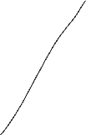
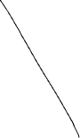


StatefulSet in action
POD-0
POD-1
POD-2
Let’s say if we scale back down to one pod
Instead of terminating random pods, a statefulset will start at the highest number and then terminate them gracefully
Here we can see that pod-1 and pod-2 has been terminated, but the storage is still been retained, so it allows us to keep the storage
files
files
files
Node
Node
files
files
files

Slide 46
StatefulSet in action
POD-0
POD-1
POD-2
As you can see there is a delicate scaled down process, so Kubernetes will take the highest number, terminate that pod, wait for that termination to be done, and then move to the lowest number in order
The same thing applies when we scale back up, Kubernetes will delicately scale one by one, so it’ll bring that pod back,
Pod-1 will have the same DNS record, the same name, despite the IP address might be different
Since it has the same DNS name as before, so its’ identity as well as its’ network identity has been persisted, the same goes for its’ storage, the pod will going to be mounting the same persisted volume again
files
files
files
Node
Node
files
files
files

Slide 47
Note:
Do not look at Kubernetes as a solution to make our application stateful
Data stores like Redis, Cassandra, MongoDB, Postgres, MySQL have clustering features
If you’re planning to building a Cassandra, MongoDB, or a Postgres, MySQL, you need to know what you’re doing
Kubernetes StatefulSet is not going to help solve the clustering components for you, and you need to know how that data store will behave, if the storages’ move, detached or distributed
By understanding how the clustering and that application works, you can apply what you’ve learned about persisted volumes and StatefulSet, to come up with a great solution
Kubernetes can totally work for stateful workloads if you know what you’re doing
You need to choose the right persisted volume for the right job, if you need high speed read-write storage, you’re gonna have trouble having a network share, and you might benefit more from using something like an SSD storage
If you’re running in the cloud, there is a high chance that your cloud provider will already have a storage offering available for you, which are Database-as-a-Service, this may cost a few dollars per month or even a few hundreds of dollars per month, but it might be totally worth it as it’ll take the burden away from your engineering team, so that they can focus on what’s important and not get stuck with data replication and high availability

Slide 48
Kubernetes Volume types
There are three components of kubernetes storage
Persistent Volume
Persistent Volume Claim
Storage Class
Let’s see what each component does and how it’s created and used for data persistence

Slide 49
The need for Volumes
Because Kubernetes doesn’t give us data persistence out-of-the-box, as such storing data inside a container filesystem will be lost when that container dies and get recreated
This is something that we have to explicitly configure for each application that needs saving data between pod restarts
Basically you need a storage that doesn’t depend on the pod lifecycle, in order to have data access even when the pod dies and gets recreated, so that the new pod can pick up where the previous one left off, then grant you access to the data
However you don’t know on which node the new pod restarts, so your storage must also be available on all nodes not just one specific one. Because then when the new pod tries to read the existing data, the newest data is there and can be read by any node in the cluster

Slide 50
The need for Volumes
1) Storage that doesn't depend on the pod lifecycle.
2) Storage must be available on all nodes.
3) Storage needs to survive even if cluster crashes.

Slide 51
Persistent Volume
Think of a persistent volume as a cluster resource, just like Ram or CPU that is used to store data
Persistent volume just like any other component, gets created using YAML files, where you can specify the kind - which is PersistentVolume and in the spec section, you have to define how much storage should be created for the volume
Persistent volume is just an abstract component, it must take the storage from the actual physical storage, like from a local hard drive, cluster node, or your external NFS servers outside of the cluster, or maybe cloud storage like AWS, or Google Cloud Storage .etc.

Slide 52
Persistent Volume
You have to think about:
What type of storage do you need?
Then you need to create and manage them by yourself
Managing here means do backups and make sure they don’t get corrupt .etc.
Think of Kubernetes as an external plugin to your cluster whether it’s a local storage, or a remote storage, doesn’t matter
You can have multiple storages configured for your cluster where one application in your cluster uses local disk storage and other one uses the NFS server, or another one uses some cloud storage, you get the point

Slide 53
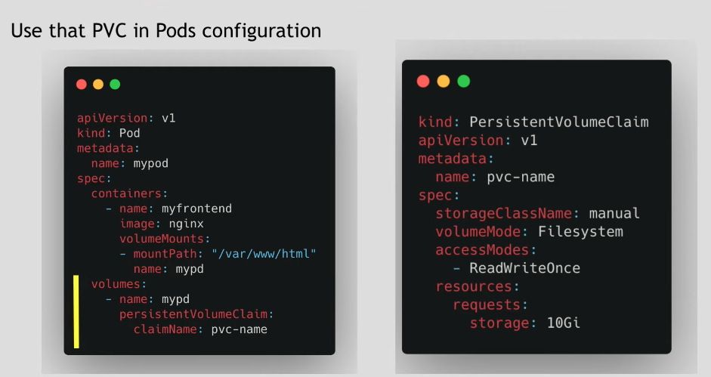
Persistent Volume Claim
A simple way to understand is PVC will “claim” a volume with certain storage size or capacity
It has some additional characteristics like access types like ReadWriteOnce, ReadOnly .etc.
Whatever PersistentVolume matches those criteria, will be “claimed” by the pod

Slide 54
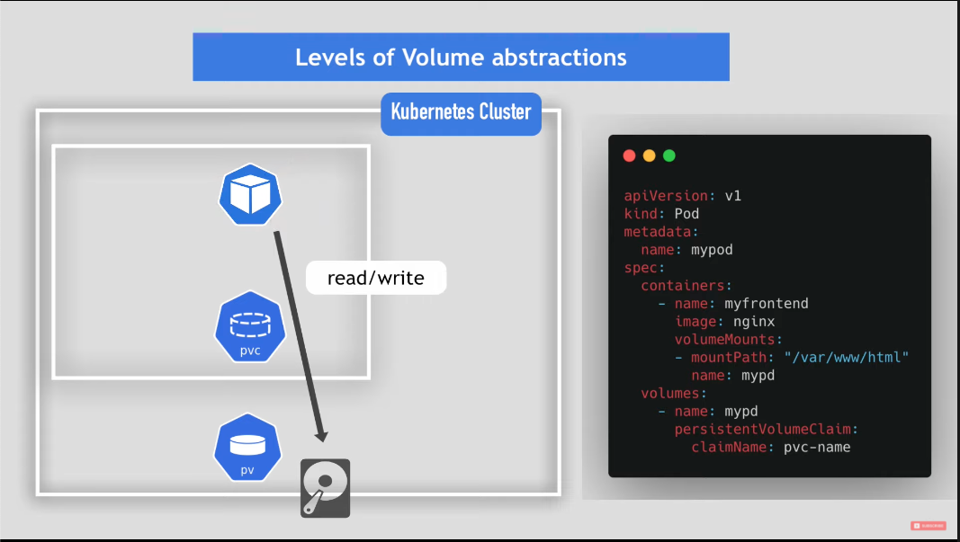

Slide 55
ConfigMap and Secret
These two are local volumes
Not created via PV or PVC
And it is managed by Kubernetes
These types of special volume is specifically used to send configuration files inside the container by:
Create ConfigMap and/or Secret component
Mount that into your pod/container – the same way as you would mount PersistentVolumeClaim

Slide 56
The demo

